Slide 1
MSc Artificial Intelligence
Knowledge Engineering
13 October 2025
Notes:
This colour bar is to be used for Artificial Intelligence

Slide 2
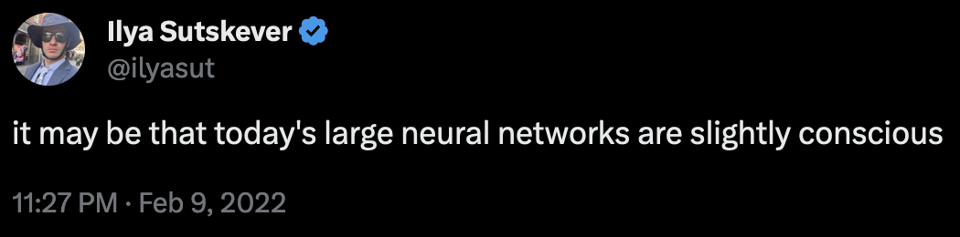
In the era of LLMs do we need all this?
Large language models like Chatgpt, Llama, Bard, Claude can understand and generate astonishingly coherent natural language
Bold claims have been made about the capabilities of these systems
Do these claims stack up?
Can LLMs reason?

Slide 3
How do LLMs work?
[You will learn more about this next term in “Natural Language Processing”]
LLMs are generative language models
Trained to generate sequences of words conditioned on
A prompt supplied by us
What they have already generated
Essentially they predict the next word in a sequence by sampling from the distribution of possible words.
Why do they work so well?
Very large neural network models
Self-supervised generative pre-training – learning to predict the training data itself
Trained on vast amounts of data

Slide 4
How do LLMs work?
Why do some people think this might lead to AGI?
Massively improved ability to generate text over previous approaches
Far better at the “Turing Test” than previous efforts
Some evidence that its output is a synthesis of its training data not a regurgitation
Wishful thinking!

Slide 5
LLMs = AGI?
Why do some people think this might lead to AGI?
Massively improved ability to generate text over previous approaches
Far better at the “Turing Test” than previous efforts
Some evidence that its output is a synthesis of its training data not a regurgitation
Wishful thinking!

Slide 6
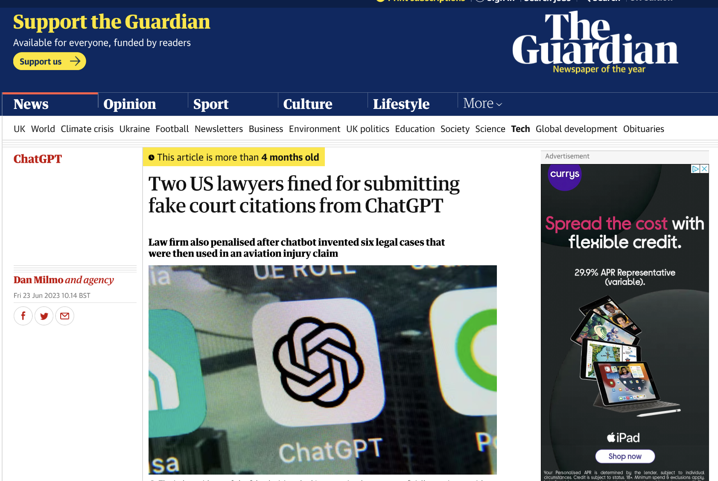
Can we trust it?

Slide 7
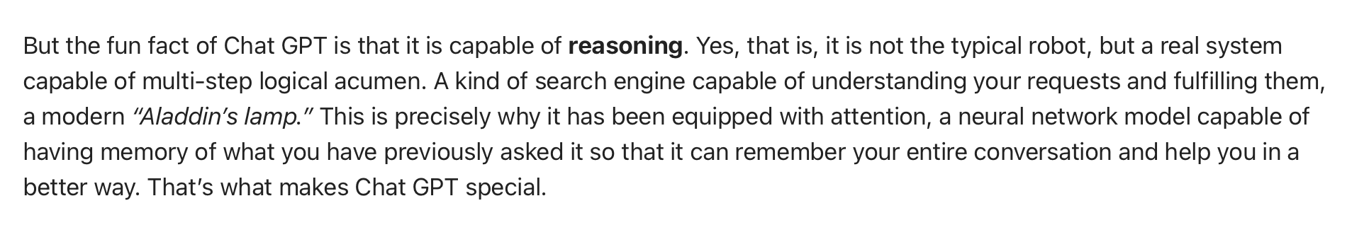
Bold Claims
Let’s find out if this is true

Slide 8
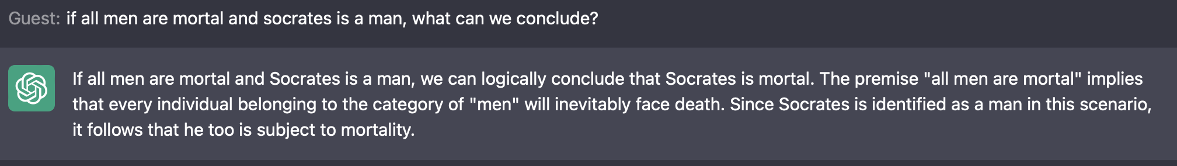
An old friend…
Can chatgpt do modus ponens?
All men are mortal
Socrates is a man…

Slide 9
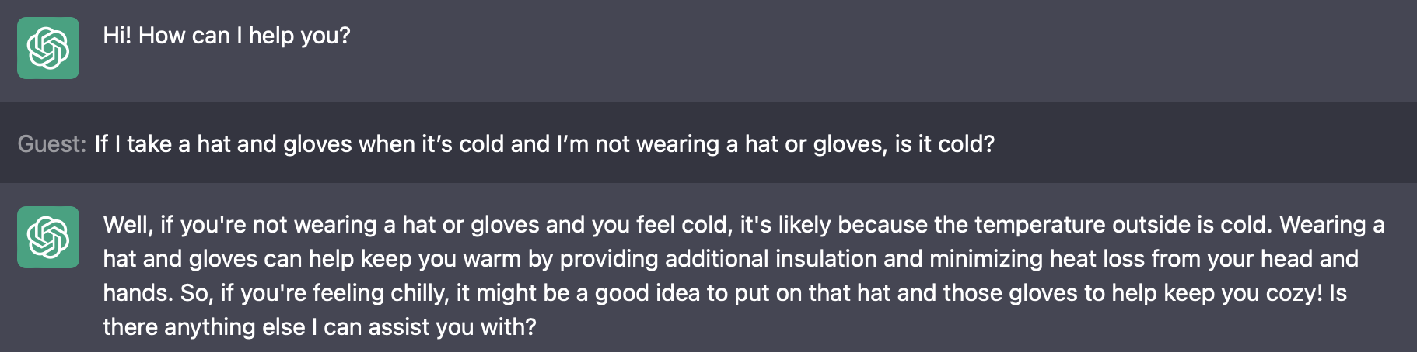
More complex arguments
If I take a hat and gloves when it’s cold and I’m not wearing a hat or gloves, is it cold?

Slide 10
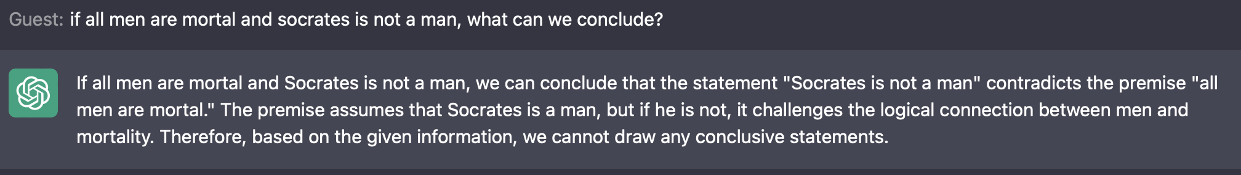
An old friend…
Can we tempt it into a logical fallacy?
All men are mortal
Socrates is not a man…

Slide 11
Exercise
Go to the exercise “Are you Logical”.
Copy and paste the first five questions (one at a time) into Chatgpt.
How does it do? Is it consistent? What sort of mistakes does it make?

Slide 12
Exercise
Go to the exercise “Elementary my dear Watson” on Monday 13 November.
Copy and paste the four parts of question 3 (one at a time) into Chatgpt. You’ll need to include the question each time.
How does it do? Is it consistent? What sort of mistakes does it make?

Slide 13
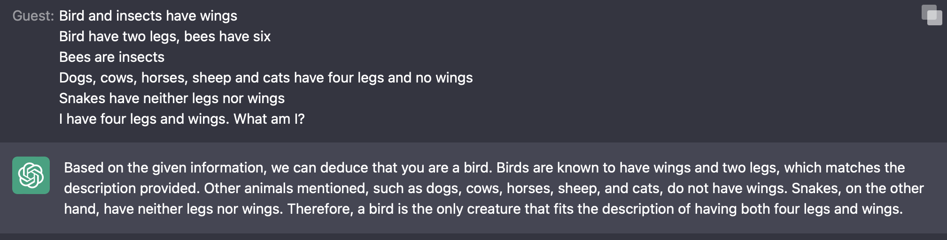
Can it reason?
Bird and insects have wings
Bird have two legs, bees have six
Bees are insects
Dogs, cows, horses, sheep and cats have four legs and no wings
Snakes have neither legs nor wings
I have four legs and wings. What am I?

Slide 14
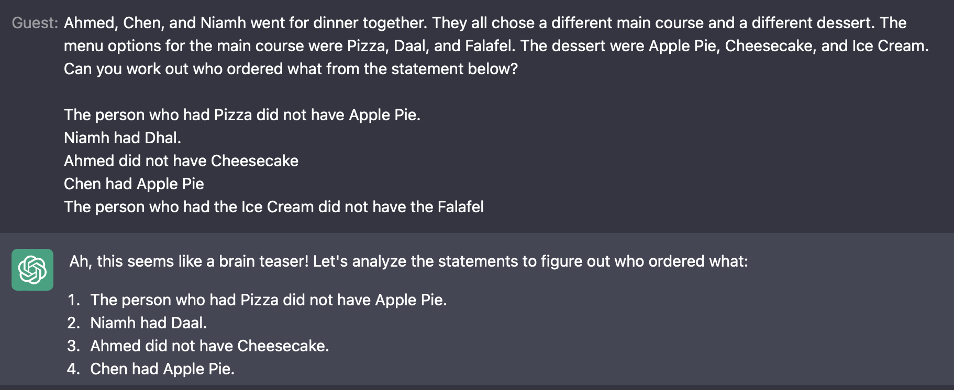
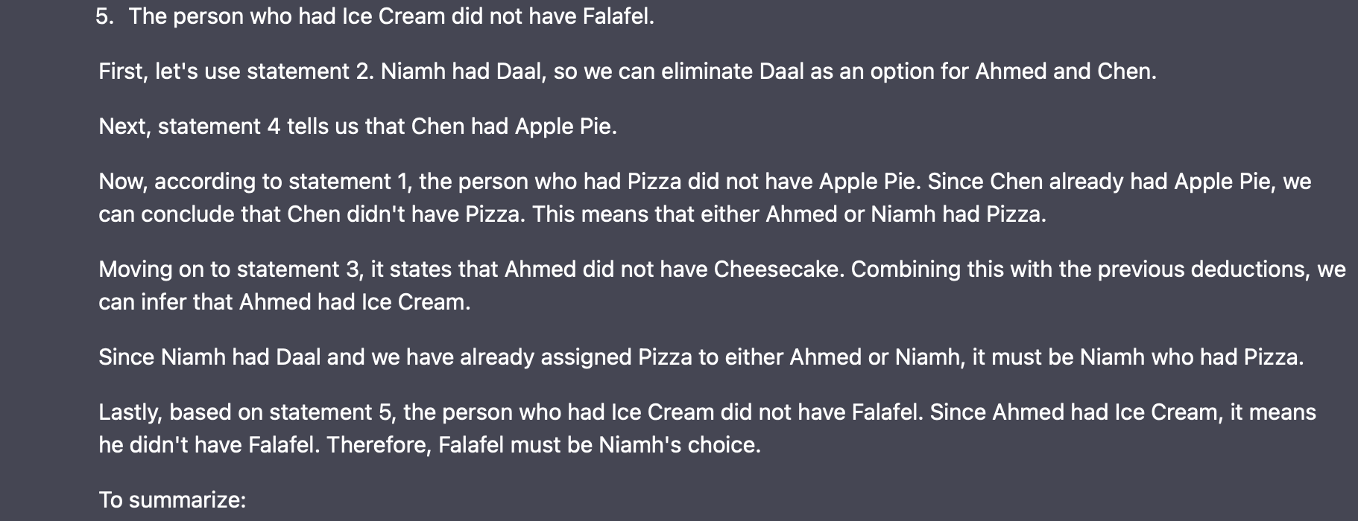


Slide 15
Challenge
Can you get ChatGPT to solve the three diners puzzle (Are you Logical, Q6)?
(You may need to edit the text to make it fit).
15-20 minutes
What sort of mistakes does it make (if it makes mistakes)?

Slide 16
Challenge
Can you get ChatGPT to solve Einstein’s Riddle (slides, Tuesday 13 November)?
(You may need to edit the text to make it fit).
15-20 minutes
What sort of mistakes does it make (if it makes mistakes)?

Slide 17
Recap
Knowledge graphs: objects (entities) linked by relations
Ontologies specify a grammar for the graph
Specify the types of entity and relation that are allowed
Knowledge Graph is the ontology populated with facts

Slide 18
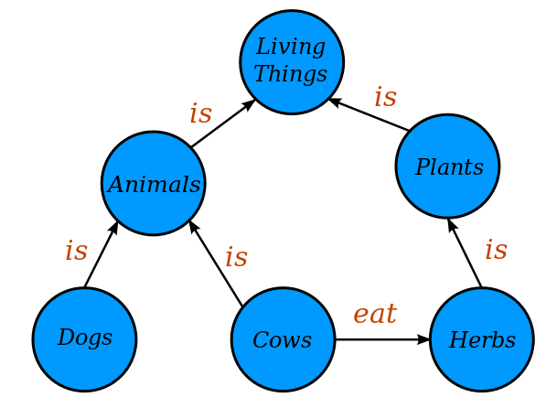
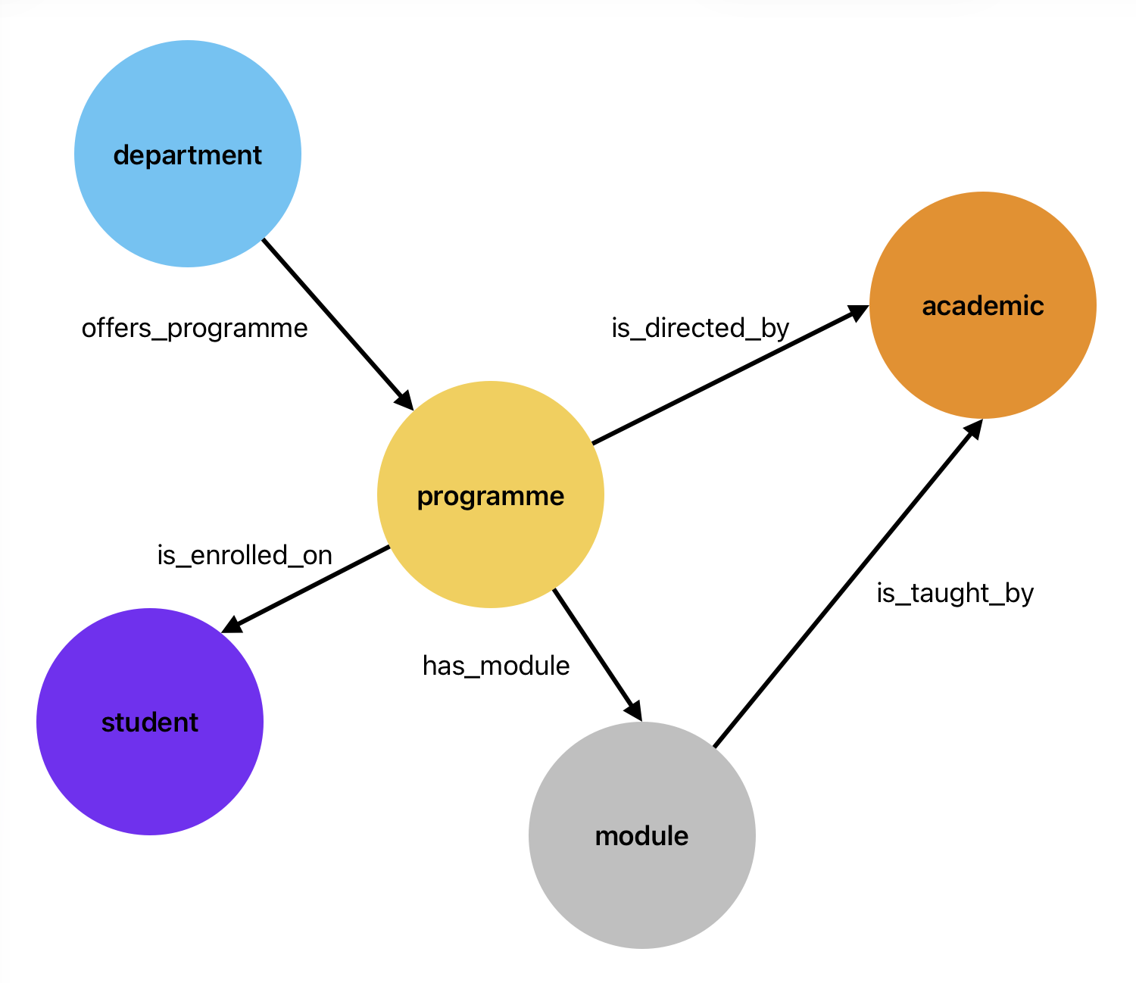
Ontologies
https://commons.wikimedia.org/wiki/File:Conceptual_Diagram_-_Example.svg licensed under the Creative Commons Attribution-Share Alike 4.0 International license.

Slide 19
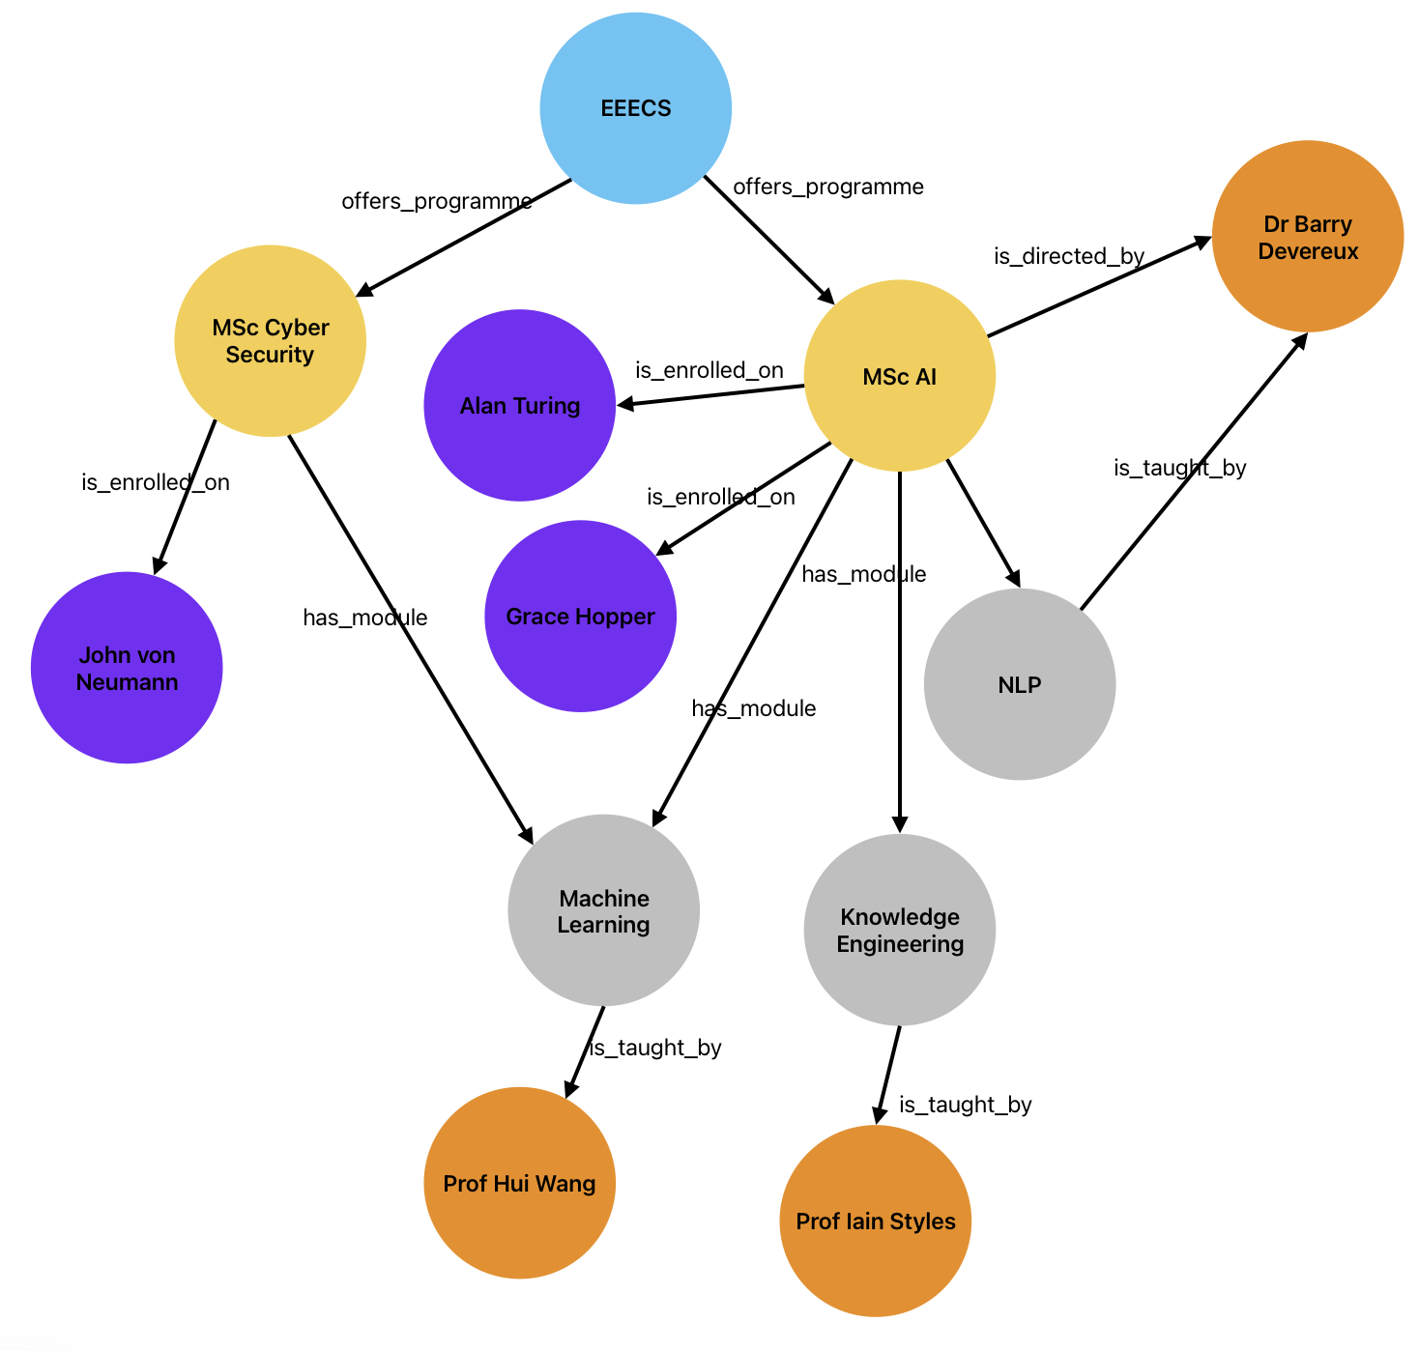
Ontologies are not Knowledge Graphs

Slide 20
Tools for Working with Graphs
Kanren – provides mechanisms for creating and querying graphs
What is missing?
Ontologies – so no error checking
Attributes – nodes only have names
“Familiar” tools for querying
Reasonable import/export mechanisms
Scalability

Slide 21
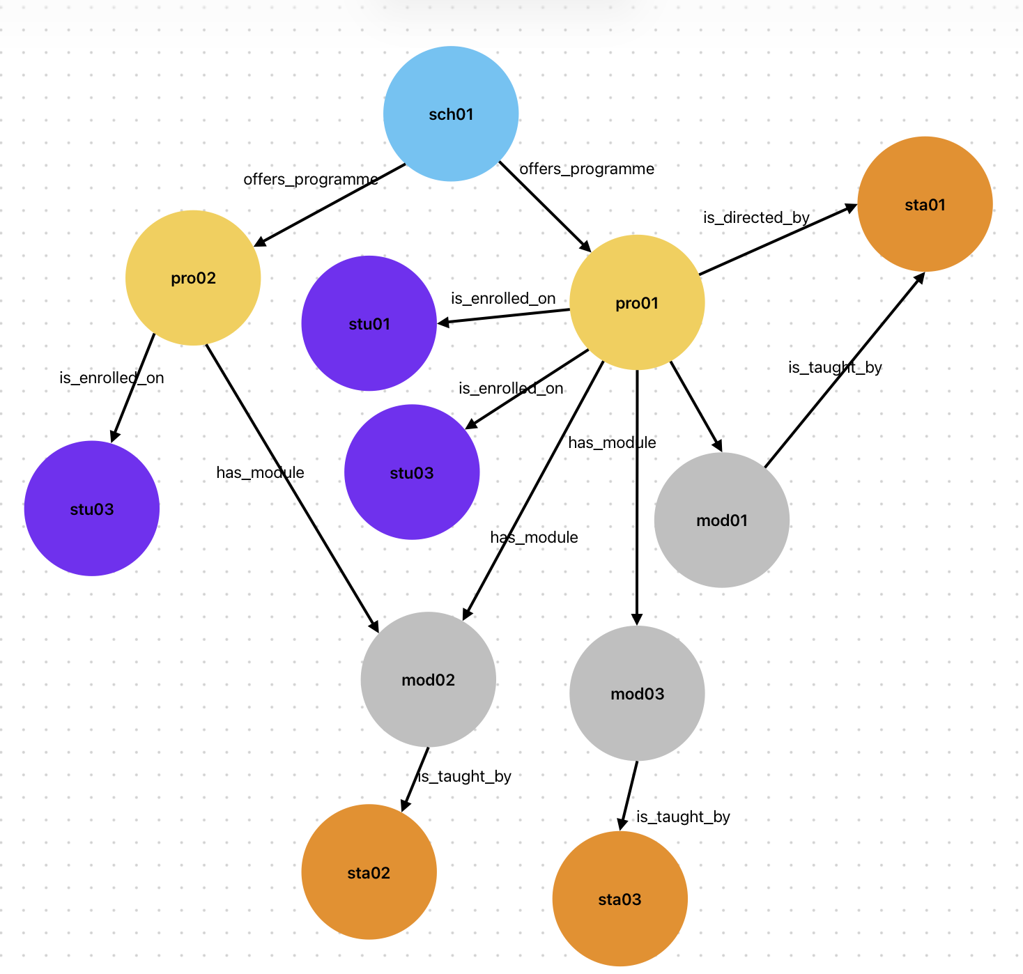
Why do we need attributes?
When would you use an attribute instead of a node?
module_title = “knowledge Engineering
module_id = “ECS8052”
name=“Iain Styles
staff_id = “123456”

Slide 22
So what do we want to do?
Specify an ontology
Instantiate it with facts
Add attributes to nodes
Query the graph using “familiar” notation
Save the graph/ontology in a well-defined and easily importable/exportable format
Perform elementary reasoning on the graph
We will use a package called owlready2 for this

Slide 23
Graph/Ontology Formats
Ontology representations designed to be “human readable” and machine parseable.
In practice, nearly always read/written by tools and read by humans only when strictly necessary.
Several common formats

Slide 24
Examples of different ontology formats
(is_a, dog, mammal)
(is_a, cat, mammal)
(chases, dog, cat)
Simple Triples format
Easy to parse
Portable
Lacks metadata
Extensible

Slide 25
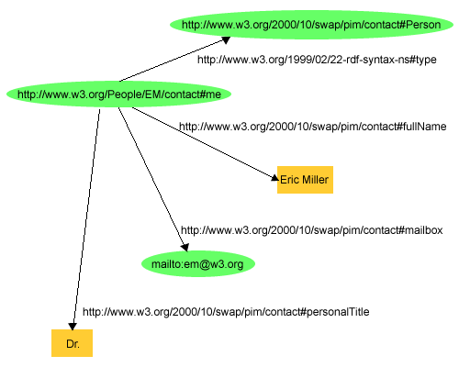
Examples of different ontology formats
<http://www.w3.org/People/EM/contact#me> <http://www.w3.org/1999/02/22-rdf-syntax-ns#type> <http://www.w3.org/2000/10/swap/pim/contact#Person> .
<http://www.w3.org/People/EM/contact#me> <http://www.w3.org/2000/10/swap/pim/contact#fullName> "Eric Miller" .
<http://www.w3.org/People/EM/contact#me> <http://www.w3.org/2000/10/swap/pim/contact#mailbox> <mailto:em@w3.org> .
<http://www.w3.org/People/EM/contact#me> <http://www.w3.org/2000/10/swap/pim/contact#personalTitle> "Dr." .
W3C N-Triples format
Subject– Predicate – Object
Designed for web data
Referenced against external W3C definitions
http://www.w3.org/TR/rdf-primer/fig1dec16.png

Slide 26
Turtle: Terse RDF Triple Language
prefix ns0: <http://www.w3.org/2000/10/swap/pim/contact#> .
http://www.w3.org/People/EM/contact#me a <http://www.w3.org/2000/10/swap/pim/contact#Person> ;
ns0:fullName "Eric Miller" ;
ns0:mailbox <mailto:em@w3.org> ;
ns0:personalTitle "Dr." .
Less repetitive and verbose than N-Triples
Namespaces and nesting

Slide 27
RDF/XML
<?xml version="1.0"?>
<rdf:RDF xmlns:rdf="http://www.w3.org/1999/02/22-rdf-syntax-ns#"
xmlns:contact="http://www.w3.org/2000/10/swap/pim/contact#">
<contact:Person rdf:about="http://www.w3.org/People/EM/contact#me">
<contact:fullName>Eric Miller</contact:fullName>
<contact:mailbox rdf:resource="mailto:em@w3.org"/>
<contact:personalTitle>Dr.</contact:personalTitle>
</contact:Person>
</rdf:RDF>
Very similar but a little more verbose than Turtle
XML-based so can use generic parsers

Slide 28
OWL: Web Ontology Language
<?xml version="1.0"?>
<rdf:RDF xmlns:rdf="http://www.w3.org/1999/02/22-rdf-syntax-ns#"
xmlns:xsd="http://www.w3.org/2001/XMLSchema#"
xmlns:rdfs="http://www.w3.org/2000/01/rdf-schema#"
xmlns:owl="http://www.w3.org/2002/07/owl#"
xml:base="http://www.dummy.info/new.owl"
xmlns="http://www.dummy.info/new.owl#">
<owl:Ontology rdf:about="http://www.dummy.info/new.owl"/>
<owl:Class rdf:about="#Animal">
<rdfs:subClassOf rdf:resource="http://www.w3.org/2002/07/owl#Thing"/>
</owl:Class>
<owl:Class rdf:about="#Dog">
<rdfs:subClassOf rdf:resource="http://www.w3.org/2002/07/owl#Thing"/>
</owl:Class>
<owl:Class rdf:about="#Cat">
<rdfs:subClassOf rdf:resource="http://www.w3.org/2002/07/owl#Thing"/>
</owl:Class>
<owl:ObjectProperty rdf:about="#is_a">
<rdfs:domain rdf:resource="#Dog"/>
<rdfs:range rdf:resource="#Animal"/>
</owl:ObjectProperty>
<owl:ObjectProperty rdf:about="#is_a">
<rdfs:domain rdf:resource="#Cat"/>
<rdfs:range rdf:resource="#Animal"/>
</owl:ObjectProperty>
<owl:ObjectProperty rdf:about="#chases">
<rdfs:domain rdf:resource="#Dog"/>
<rdfs:range rdf:resource="#Cat"/>
</owl:ObjectProperty>
</rdf:RDF>
Like many XML formats, can be very verbose.
XML tooling.
Referenced against external definitions.

Slide 29
Documentation
I found all of the following helpful
https://owlready2.readthedocs.io/en/v0.42/
https://kgtutorial.github.io/
https://jingdongsun.medium.com/creating-knowledge-graph-step-by-step-a383231acf2d
https://iccl.inf.tu-dresden.de/web/Knowledge_Graphs_(WS2021)/en

